Slide 1
BDSN Assignment
Crew Members Prediction

Slide 2
Introduction
Hyundai Heavy Industries is one of the world's largest ship manufacturing companies and builds cruise liners.
The Shipbuilding Division is capable of building all types of ships to meet various demands from its clients.
1135 ships, 182 shipowners, 3000 employees

Slide 3
Problem Statement
It is important to use the crew resources for building these many ships efficiently.
If the estimation of required crew members for building a ship is wrong, it could cost the company,
Fast and accurate allotment of crew resources is required.

Slide 4
Dataset
Ship Name 1-20
Cruise Line 21-40
Age (as of 2013) 46-48
Tonnage (1000s of tons) 50-56
passengers (100s) 58-64
Length (100s of feet) 66-72
Cabins (100s) 74-80
Passenger Density 82-88
Crew (100s) 90-96

Slide 5
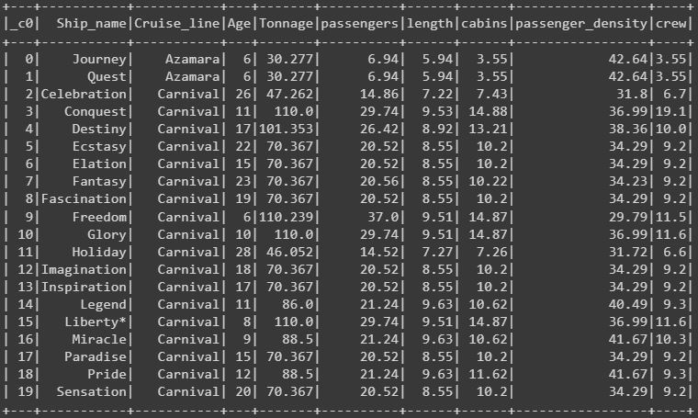
Dataset

Slide 6
Approach
We will use pySpark and Python to build a model that will estimate number of crews required.
StringIndexer maps a string column of labels to an ML column of label indices
VectorAssembler is a feature transformer that merges multiple columns into a vector column.
We will use Linear Regression to estimate the number of crew members.

Slide 7
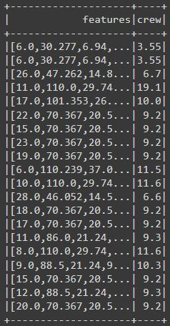
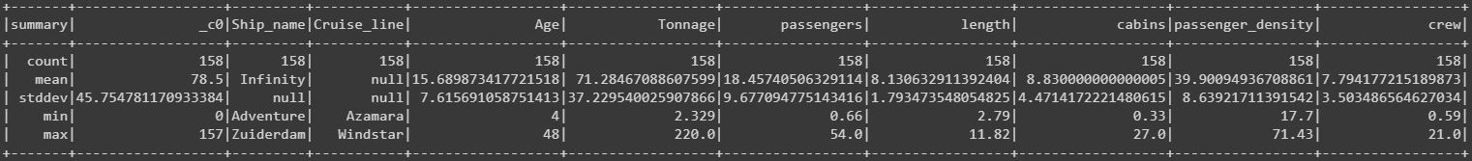
Approach
Data Description

Slide 8
Linear Regression Model
Coefficients: [-0.006003614763547642,0.005816222140279991,-0.1340582665202412,0.4713718698405512,0.8544279060933411,-0.005989971174231681,0.042526741363031945]
Intercept: -1.3009066092088724
Y = -0.006x1 + 0.005x2 - 0.134x3 + 0.471x4 + 0.524x5 - 0.005x6 + 0.042x7

Slide 9
Linear Regression Model
Y = -0.006x1 + 0.005x2 - 0.134x3 + 0.471x4 + 0.524x5 - 0.005x6 + 0.042x7
X1 = Age
X2 = Tonnage
X3 = Passengers
X4 = Length
X5 = Cabins
X6 = passenger Density
X7 = cruisecat

Slide 10
Model Evaluation
There are many evaluation metrics for Linear Regression Model.
We used Rmse, Mse and R-Square.
RMSE: 0.8359817428705837
MSE: 0.6988654744129387
R2: 0.9277491710687162

Slide 11
Conclusion
We can now predict the number of crew members required to build a ship with Mean Squared Error of 0.69.
The user has to enter all the features Age, Tonnage, Passenger, Length, Cabins, Passenger Density, cruisecat and the model will predict the number of crew members required

Slide 12
References
https://english.hhi.co.kr/img/filedown/HHI_ShipbuildingBrochure_210824_1.pdf
https://english.hhi.co.kr/biz/ship_over
https://spark.apache.org/

